Slide 1
Problem Statement
A surface contains total 10 tracks. Each track contains 20 blocks. The head covers the total surface in 1 min and the rotation speed is 4200 rpm. Suppose the head is positioned over track 3. It needs to read 18 no block of track 8. Now find the total access time.

Slide 2
Difference between Rotation and cover
Search for blocks
Goes from one track to another

Slide 3
Solution
Total time= seek time + latency + reading time
Reading time =0
Seek time ,
For covering 10 tracks, head needs 60 sec
For covering 1 track = 6 sec
Total seek time (8-3)*6=30 sec

Slide 4
Solution
Latency ,
4200 rotation in 60 sec
1rotation in 0.014 sec
1 rotation =20blocks
20blocks need 0.014 sec
18blocks need 0.0128 sec
So total access time = (30+0.0128) sec= 30.0128 sec

Slide 5
Magnetic disc problem
Problem Solved by zoning:
Outer track have lower density than it’s capability
For out circle memory will be waste.
Problem Solved by interleaving :
Disk controller may have slow process, so we can lost data.

Slide 6
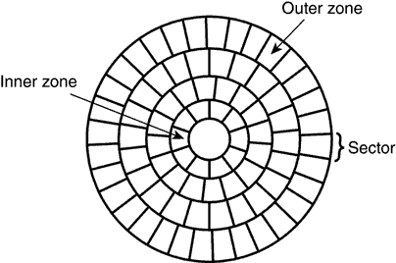
Zoning
Outer tracks are loaded at much lower density than they are capable of
Here surface is divided different zones
Number of sectors are constant within a zone

Slide 7
Outer zones contain more sectors for each track
More space is utilized
Additional advantage of zoning:
Sectors in outer zone can be read more quickly
Most commonly used blocks can be placed in outer zone

Slide 8
Interleaving
If necessary block access are from same track
No time is wasted in seeking
If not in the same track but also in consecutive sectors on that track
latency is also eliminated
Sectors can be interleaved
The choice of interleave factor depends upon the usual delay between reading block

Slide 9
7
0
5
0
6
1
2
3
5
2
7
6
4
3
1
4
Interleave factor of 1
Interleave factor of 3

Slide 10
Magnetic Disk organization
Reading Information Consists 3 part:
Head moves to desire track
Hunt the required block
Finally read the data
For going to the desire location the process needs some information to work on. Disk formatting is done for initialize the information.

Slide 11
Disc formatting
Reading information from disc consists of 3 parts
Seeking
Latency
Data read/write
In order to identify tracks and sectors
Control information is recorded in addition of user data
Writing of this information is called formatting disc

Slide 12
Magnetic Disk organization
Disk Format:
1. Low level formatting
2. High level formatting

Slide 13
Magnetic Disk organization
Control Information :
Index Marker | Sector 0 header | Data | Sector 0 Trailer | Sector 1 header

Slide 14
Problem Statement
A platter having 8 surfaces.
2048 tracks/ surface
65536 blocks/ surface
52 bytes/ block
Find out the number of the cylinder, total number of sector per tracks, total capacity of the platter having 5% of wastage.

Slide 15
Solution
Number of tracks in one surface = number of cylinders of that platter = 2048
2048 tracks contain 65536 block
1 track contains 65536/2048 blocks =32 blocks
Total capacity = 65536 * 52 * 8 *.95 = 25899827 =25892MB

